Slide 1

RUNGTA COLLEGE OF DENTAL SCIENCES & RESEARCH
TITLE OF THE TOPIC:ENDO-PERIO LESION
DEPARTMENT OF CONSERVATIVE DENTISTRY AND ENDODONTICS

Slide 2
Specific learning Objectives
At the end of this presentation the learner is expected to know ;
Core areas* | Domain ** | Category #
Develpmental malformation | COGNITIVE | MUST NOW
Classification | PSYCHOMOTOR | NICE TO KNOW
Influence of periodontal problem on pulp | AFFECTIVE | DESIRE TO KNOW

Slide 3
CONTENTS
Developmental malformation
Classification
Influence of periodontium on pulp
Influence of pulpal pathological condition on pulp

Slide 4
FISTULA TRACKING
Endodontic or periodontal disease may sometimes develop a fistulous sinus track.
Inflammatory exudates travel through tissues and structures of minor resistance
Open anywhere on the oral mucosa or facial skin..

Slide 5
Intraorally - attached buccal gingiva or in the vestibule
Extraorally - face and neck (cheek, chin, angle of mandible)
Identifying the source of inflammation by tracking the fistula will help the clinician to differentiate between diseases of endodontic and periodontal origin.

Slide 6
Fistula tracking is done by inserting a semi-rigid radiopaque material into the sinus track until resistance is met.
Materials : Gutta-percha cones or
Presoftened silver cones.

Slide 7
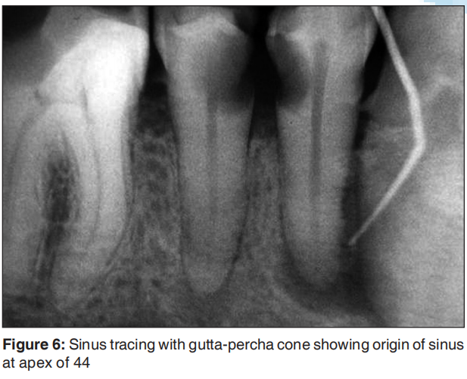
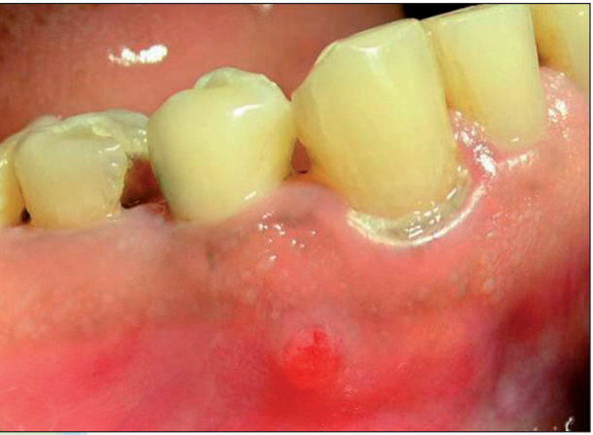

Slide 8
TRANSILLUMINATION
Identification of cracks and fractures in the crown.
A fiberoptic connected to a high-power light source is used to illuminate the crown and gingival sulcus.
Contrast between the dark shadow of the fracture and the light shadow of the surrounding tissue

Slide 9
WEDGING
Identification of vertical crown fractures or crown–root fractures.
During the test, wedging forces are created as the patient is instructed to chew on a cottonwood stick or other firm material.
This test is reliable in identifying a single tooth causing pain during mastication.

Slide 10
STAINING
Identifies lines of fracture in the crown and root
The tooth crown is dried and a cotton pellet soaked with methylene blue dye is swabbed on the occlusal surface of the tooth.
The patient is asked to bite on a stick and perform lateral jaw movements.

Slide 11
Dye penetrates well into the zone of the fracture which is then rinsed from the tooth surfaces
Visual examination with magnifying loops or the microscope will reveal a distinctive fracture line darkened with dye.

Slide 12
SELECTIVE ANESTHESIA TEST
Useful in cases where the source of pain cannot be attributed to a specific arch.
Disappearance of pain following a mandibular block will confirm the source of pain originating from a mandibular tooth.
The periodontal ligament injection is often used

Slide 13
Maxillary arch - more focused to specific tooth by injecting a small amount of anesthetic solution in an anterior–posterior direction at the root apex level.

Slide 14
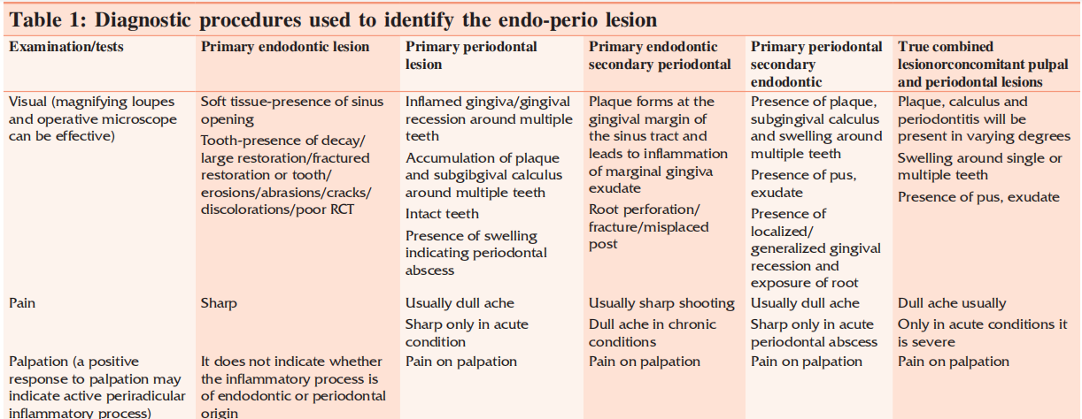

Slide 15
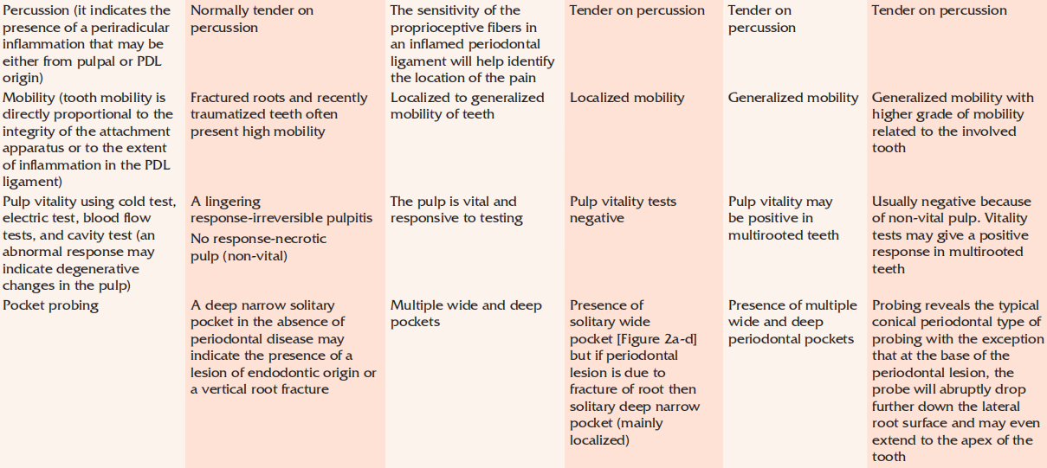

Slide 16
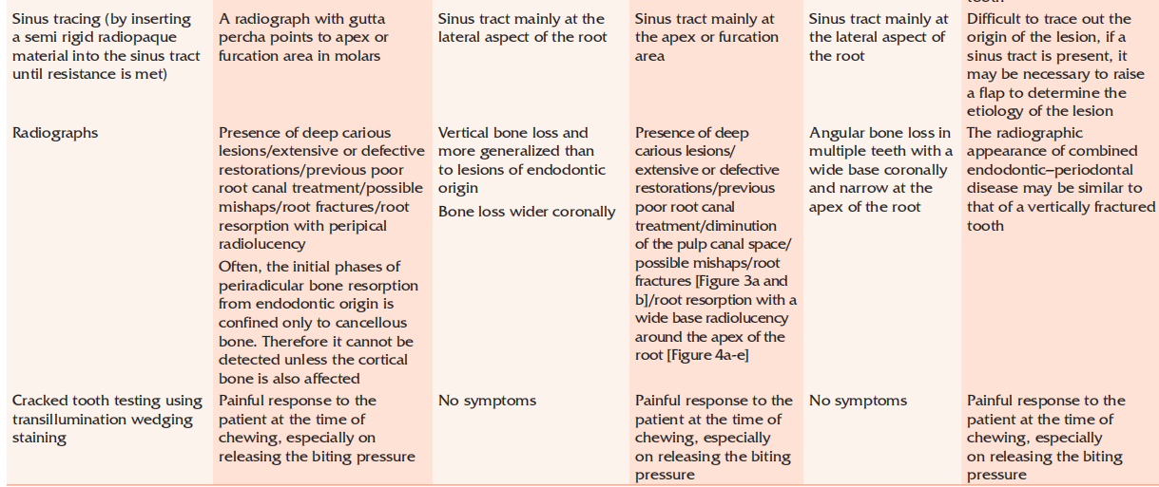

Slide 17
TREATMENT ALTERNATIVES
Consist of resection or regenerative approaches.
Resection techniques focus on eliminating the diseased roots or teeth
Regenerative efforts are aimed at restoring lost biologic structures.

Slide 18
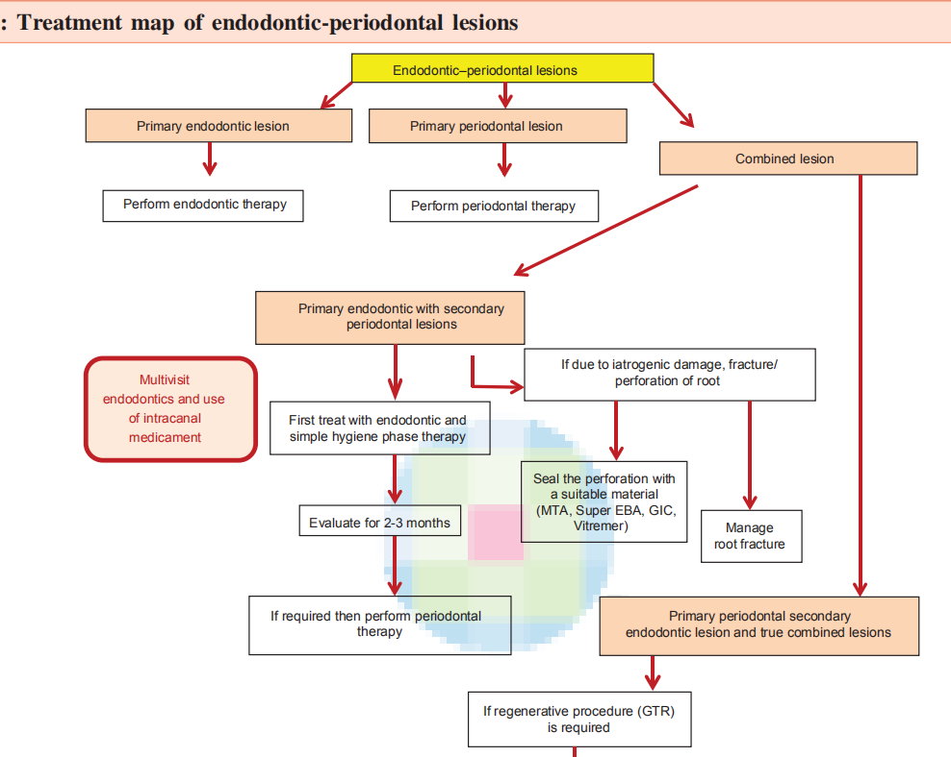

Slide 19
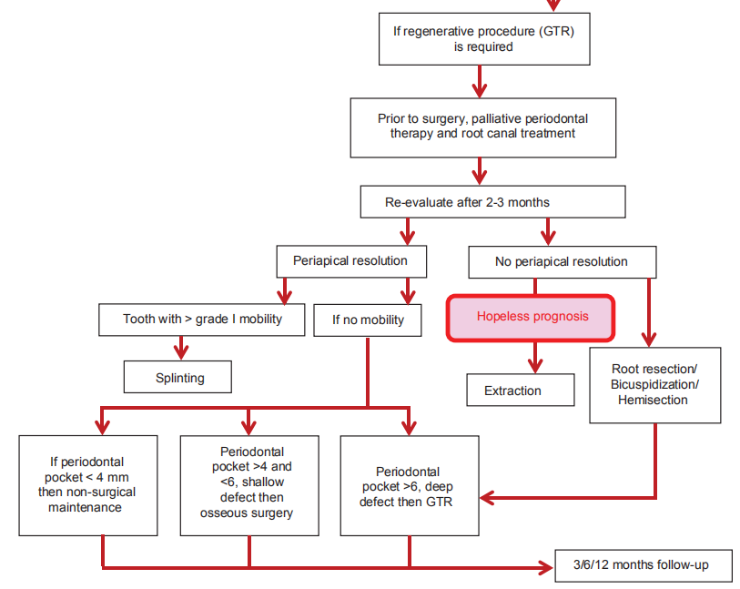

Slide 20
ROOT RESECTION
Root resection is the removal of a root, with accompanying odontoplasty before or preferably after endodontic treatment.
Indications
Root fracture,
Perforation,
Root caries,

Slide 21
Dehiscence,
Fenestration
External root resorption involving one root,
Incomplete endodontic treatment of a particular root,
Severe periodontitis affecting only one root, and
severe grade II or grade III furcation involvement.

Slide 22
TAKE HOME MESSAGE
Because of its history, the complex amalgam restorations may be the most frequently placed complex restoration.
However due to the increasing benefits of composites, the many types of auxiliary retention forms available, and the variations of tooth preparations required for complex restorations, the operator should be familiar with all of these techniques, if he or she is to use these restorations on a regular basis.

Slide 23
QUESTIONS
What is the influence of periodontium on the pulp
Pathological condition of pulp on periodontium

Slide 24
REFERENCES:
1. Sturdevant's Art and Science of Operative Dentistry - fourth Edition
2. Operative Dentistry - Modern theory and practice - First Edition- M.A. Marzouk
3. Text book of operative dentistry - Vimal K. Sikri
4.Fundamentals of Operative Dentistry- Summit JB- 2nd edition
5.Text book of operative dentistry → nisha carg,amit carg
6.Principles and Practice of Operative Dentistry-Gerald T. Charbeneau-Third edition.
7.Clinical operative dentistry-principles and practice→ramya Raghu,Raghu sreenivasan

Slide 25
THANK YOU

